Slide 1

BONE TUMORS
Basic

Slide 2
Plain X rays SEVEN
Where is the lesion – what bone and what part
of the bone
Age & size of the lesion?
What is the lesion doing to bone?
What is the bone doing in response?
Is the lesion making matrix?
Is the cortex eroded?
Is a soft tissue mass evident?

Slide 3

How are bone tumours
Like Real Estate ?
LOCATION !
LOCATION !
LOCATION !

Slide 4
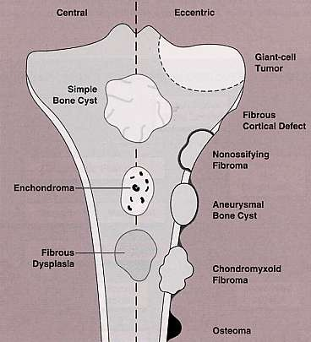
LOCATION
In the transverse plane:
  Central – Enchondroma
  Eccentric -GCT, osteosarcoma,
chondromyxoid fibroma
  Cortical - Non-ossifying fibroma,
osteoid osteoma
  Parosteal - Parosteal osteosarcoma,
osteochondroma
In the longitudinal plane:
Diaphyseal: Ewings, Osteoid Osteoma, Mets, Adamantinoma, Fibrous Dysplasia
Epiphyseal: Chondroblastoma,GCT, Ganglion of Bone.
Metaphyseal: Everything!!!!!!

Slide 5
Characteristic Location
Some tumors almost exclusively occur at specific sites
Chondroblastoma -
Epiphyses
Epiphyses
  Proximal humerus
  Tibia
  Sacrum
  Posterior element of spine
  Pelvis
Giant Cell tumor Simple bone cyst Adamantinoma Chordoma Osteoblastoma Chondrosarcoma

Slide 6

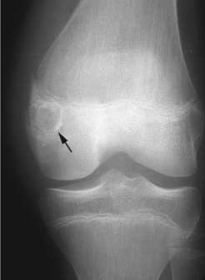
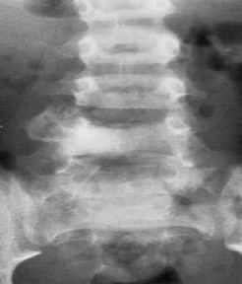
Characteristic Locations
Epiphysis
Spine, posterior
Chondroblastoma
Osteoblastoma

Slide 7
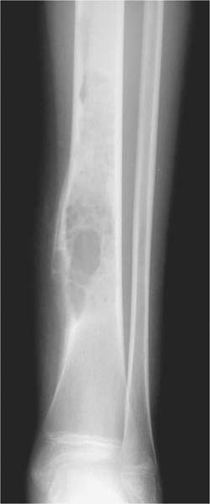
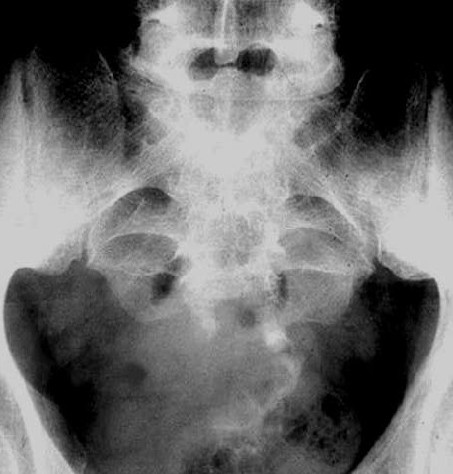
Tibia
Sacrum, clivus
Adamantinoma
Chordoma

Slide 8
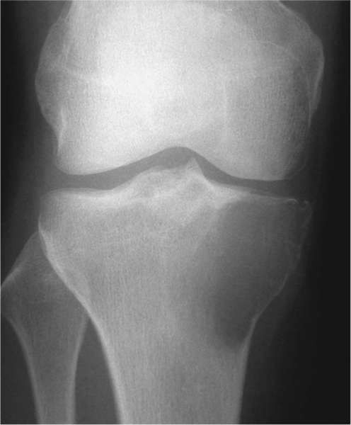
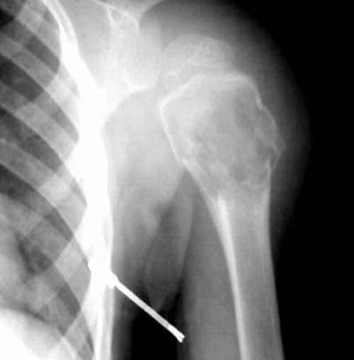
Epiphyses
Giant Cell tumor
Proximal humerus
Simple bone cyst

Slide 9
Age of the patient
20>…..Osteogenic Sarcoma, Ewings. simple bone cysts and chondroblastomas
40……GCT, Chondrosarcoma, MFH, Lymphoma, Mets.
60……Mets, Myeloma, Chondrosarcoma, MFH
– Late Osteogenic, Fibrosarcoma.

Slide 10
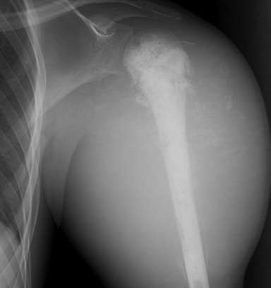
Size
In general The larger the lesion the more likely it is to be aggressive or malignant
(some exceptions i.e. fibrous dysplasia)
The bigger the uglier

Slide 11
What is the bone doing to the tumor ?
Bone reacts in two ways -- either by removing some of itself or by creating more of itself.
If the disorder is rapidly progressive, there may only be time for retreat (defense).
If the process is slow growing, then the bone may have time to mount an offense and try to form a sclerotic area around the offender.

Slide 12
Periostitis
A periosteal reaction will occur whenever the periosteum is irritated.
This may occur due to a malignant
tumor, benign tumor, infection or trauma.
Two types Benign or Aggressive.
Benign
  None
  Solid
Aggressive or malignant
Lamellated or onion peel
Sunburst
Codman’s triangle

Slide 13




Solid
Benign
Aggressive
Lamellated
V . Aggressive
Spiculated
Codman's

Slide 14


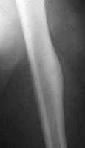
Solid Periosteal Response
Slow-growing tumors provoke focal cortical thickening
A continuous layer of new bone that attaches to outer cortical surface
Related to a slow form of irritation osteoid osteoma

Slide 15
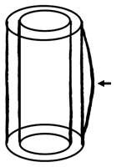
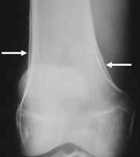
Unilamellated periosteal reaction
Single layer of reactive periosteum. … thick unilamellated periosteal reaction. Smooth and continuous
Hypertrophic osteoarthropathy

Slide 16
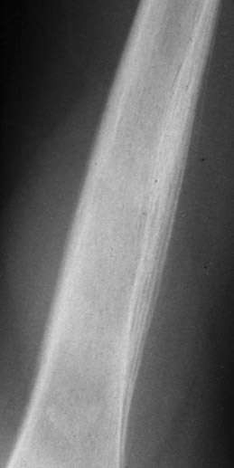


Aggressive Periostitis
Layered, onion-skin, lamellated
Alternating layers of opaque and lucent densities
Can be seen with slow growing and aggressive tumors and infections
appearance of aggressive periostitis in Ewing’s sarcoma
growth spurt.

Slide 17
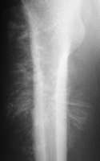
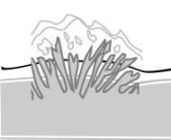
Spiculated periosteal reaction.
Osteosarcoma
Perpendicular, brushed whiskers, hair-on-end, Fine linear spiculations of new bone oriented perpendicular to the cortex or radiating from a point source indicative of very aggressive bone tumors

Slide 18
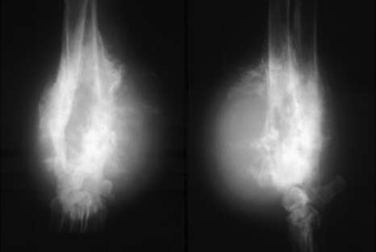
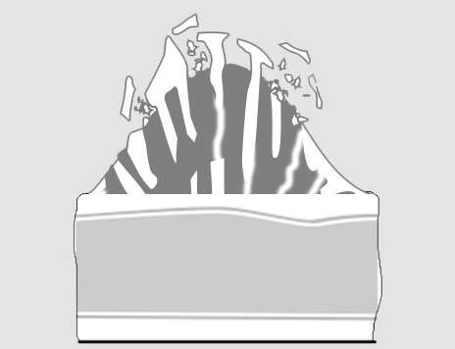
“sunburst”
This is a very aggressive process
Bone is formed in a disorganized fashion
Process may destroy spicules of bone as they are being formed

Slide 19
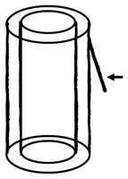
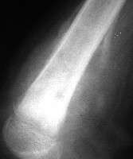
Codman's triangle
Too fast growth for periosteum to respond only the edges of raised periosteum will ossify forming a small angle with the surface of bone.
seen in malignant bone tumors and in rapidly growing lesions .. aneurysmal bone cyst, subperiosteal hematoma.

Slide 20


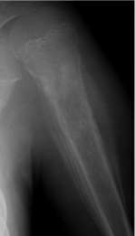
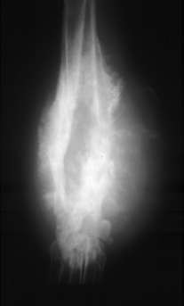
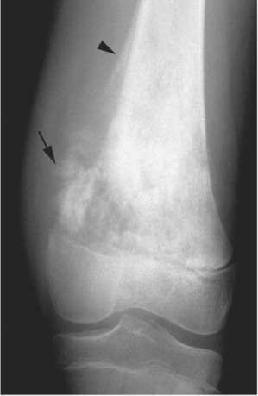
Periosteal Reactions
Solid
onion-peel
Sunburst
Codman’s triangle
Less malignant
More malignant

Slide 21
Zone of Transition
Most reliable indicator for benign versus malignant lesions.
“Narrow”, if it is so well defined that it can be drawn with a fine-point pen.
“Wide”, if it is imperceptible and can not be drawn at all. An aggressive process should be considered, although not necessarily a malignant lesion.

Slide 22
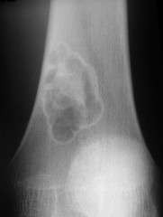
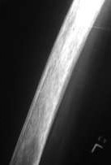
ZONE OF TRANSITION
NARROW ZONE
WIDE ZONE

Slide 23









Three Patterns of Bone Destruction
Geographic Pattern
Moth-Eaten Pattern
Permeative Pattern
Result from the degree of aggressiveness of the lesion

Slide 24
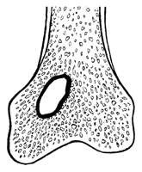
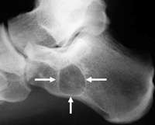
Type
1 a Geographic Lesion.
Well-defined lucency
with sclerotic rim.
Intra osseous lipoma with a sclerotic rim .

Slide 25
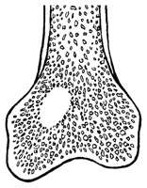
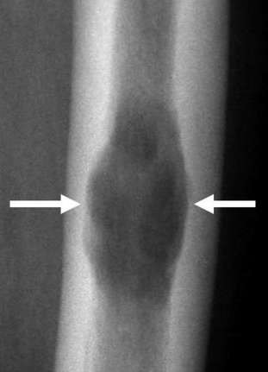
Type 1 b
Geographic Lesion
well-defined lucent lesion without sclerotic rim.
Well-defined geographic lytic focus without sclerotic rim , Endosteal scalloping seen.
myeloma

Slide 26
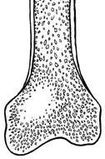
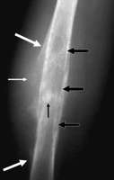
Type 1 c
Geographic Lesion
ill-defined lytic lesion
Large ill-defined lytic lesion , Codman’s triangle Periosteal interruption, Tumor-induced new bone .
osteosarcoma
.

Slide 27
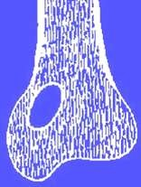
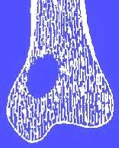
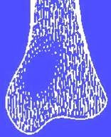
Margins: 1A, 1B, 1C
IA: GEOGRAPHIC DESTRUCTION WELL – DEFINED WITH SCLEROSIS IN MARGIN
IB: GEOGRAPHIC DESTRUCTION WELL – DEFINED BUT NO SCLEROSIS IN MARGIN
IC : GEOGRAPHIC DESTRUCTION WITH ILL DEFINED MARGIN
increasing aggressiveness

Slide 28
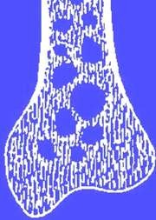
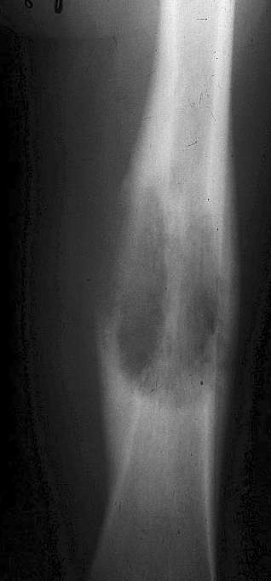
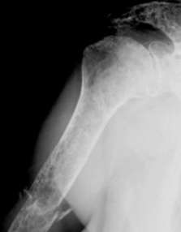
Type 2 Moth-eaten Appearance
Areas of destruction with ragged borders
Implies more rapid growth
Probably a malignancy
osteosarcoma

Slide 29
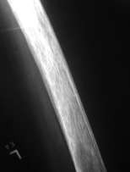
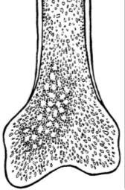
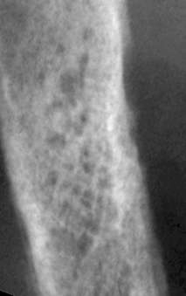
Type 3. Permeative Pattern
ill-defined lesion
with multiple “worm-holes” Spreads through marrow space Wide transition zone
Implies aggressive malignancy
Round-cell lesions
Leukemia
Ewing sarcoma.

Slide 30

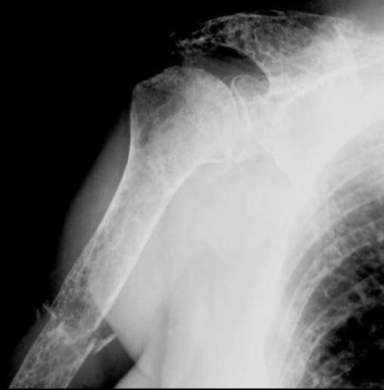
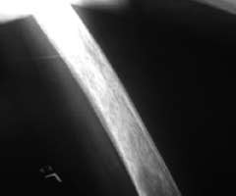
Patterns of Bone Destruction
Geographic
Moth-eaten
Permeative
Less malignant
More Malignant

Slide 31
Is the Cortex Eroded?
Cortical erosion is hallmark of active, aggressive, or malignant tumors.
High-grade malignant tumors may erode through cortex with ineffective periosteal response to erosion
In general, low grade tumors will produce endosteal erosion with orderly response; high grade tumors will erode through the endosteal surface without adequate response, increasing surface risk of fracture

Slide 32
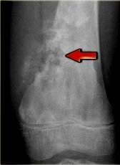
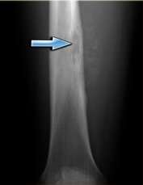
Osteosarcoma
Ewings sarcoma
Complete destruction may be seen in high-grade malignant lesions, but also in locally aggressive benign lesions like EG and osteomyelitis.

Slide 33
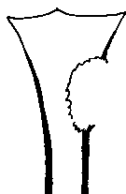
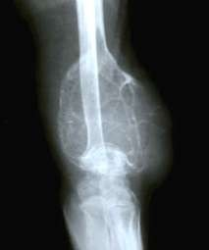
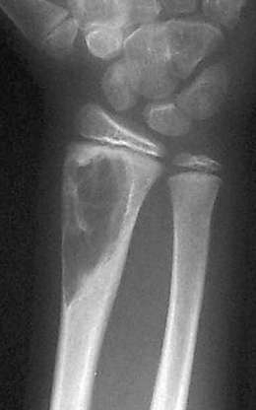
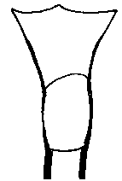
"Cortical Erosion" destruction of cortex by a lytic or sclerotic process.
Cortical erosion
"Endosteal Scalloping" Thinning of the cortex by an intraosseous process

Slide 34
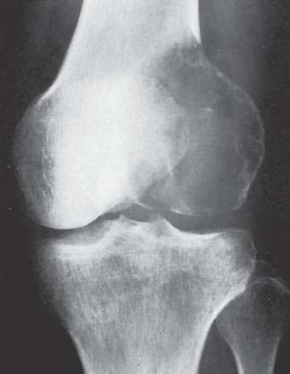
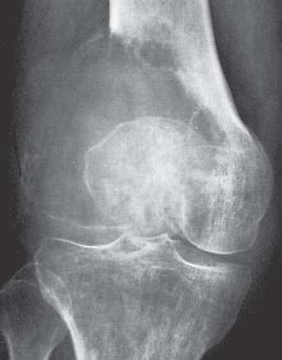
Giant cell tumor.
Malignant

Slide 35
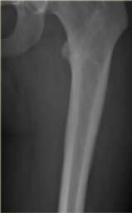
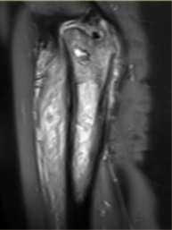
Cortical destruction
In tumors like Ewing's sarcoma, lymphoma and small cell
osteosarcoma, cortex may appear normal radiographically, while there is permeative growth throughout Haversian channels.
These tumors may be accompanied by a large soft tissue mass while there is almost no visible bone destruction.

Slide 36
Cortical Destruction
The presence of cortical destruction is not a reliable indicator of whether the lesion is a malignant process or a benign process.
Other radiographic findings must also be examined.

Slide 37
Is the lesion making matrix?
Matrix is the dominant internal extracellular substance of a lesion.
Most tumor have soft tissue matrix-Radiolucent (lytic)
on X-ray
Chondroid matrix -Calcified rings, arcs, dots Osteoid matrix- Bone forming

Slide 38


Clear Matrix
"Clear Matrix" refers to lesions which are clear or mostly clear. A radiolucent lesion with few undestroyed trabeculae is considered to have a clear matrix.

Slide 39



Patterns of mineralization of cartilaginous tumor matrix
Stippled
Flocculent
Ring and arc

Slide 40


Punctate and arc like mineralization
Chondrosarcoma
Enchondroma

Slide 41


Chondral-type matrix mineralization and endosteal scalloping .
chondrosarcoma

Slide 42







Patterns of mineralization of osseous matrix
Solid
Cloudlike
Ivory-like
opacity

Slide 43


Let’s turn from spectators into participants.
‘ What I hear, I forget ; what I see, I remember ; what I do, I understand. ’

Slide 44

AGE 13 Y
AGE
Location
Margins
Periosteal reaction
Matrix
other
DX

Slide 45
AGE | 13
Location | Metadiaphysis
Margins | 1A-1B
Periosteal reaction | none
Matrix | None
other | Trabecular struts
DX | UBC

Slide 46


ADULT
AGE
Location
Margins
Periosteal reaction
Matrix
other
DX

Slide 47

Age | Adult
Location | metaphysis
Margin | 1B
Periosteal reaction | None
Matrix | None
other | fx
DX | ABC

Slide 48

13 Y/O WITH KNEE PAIN
AGE
Location
Margins
Periosteal reaction
Matrix
other
DX

Slide 49

AGE | 13
Location | Epiphyseal
Margins | IB
Periosteal reaction | None
Matrix | None
Other DX | Chondroblastoma

Slide 50

45 Y/O MALE
AGE
Location
Margins
Periosteal reaction
Matrix
other
DX

Slide 51

Age | 45
Location | Metaphysis
Margins | 1B
Periosteal reaction | None
Matrix | None
Other | Epi involvement
DX | GCT

Slide 52

ELDERLY PT
AGE
Location
Margins
Periosteal reaction
Matrix
other
DX

Slide 53


Slide 54


Slide 55

25 Y/O WITH THIGH PAIN
Age
Location
Margin
Periosteal reaction
Matrix
Other
Dx

Slide 56


Age | 25
Location | Diaphysis
Margin | 1B
Periosteal reaction | Thick
Matrix | faint
Other Dx | Osteoid osteoma

Slide 57

Benign vs. Malignant

Slide 58

Don’t Give Flash Diagnosis !!!!
Think of the age of the patient.
Think of where the abnormality is …. or isn’t.
Think of the tissue categories of tumors.
Think in terms of benign, benign aggressive or malignant.

Slide 59
Don’t ever look at MRI or CT scan Before plain X-rays

Slide 60
Aggressive Lesions
Non-aggressive Lesions
Poorly demarcated
Wide zone of transition
Poorly marginated osteolysis Cortex interrupted
Interrupted irregular periosteal reaction
No surrounding sclerosis Rapid rate of change
Well demarcated
Narrow zone of transition Absent or geographic osteolysis
Cortex may be displaced, remodeled and thin, but not broken
Solid, smooth periosteal reaction
+/- surrounding sclerosis Static or slow rate of change

