Slide 1
METABOLIC BONE DISORDERS
Dr kutsi tuncer

Slide 2
Generalized
Bone turnover affected
Not infections
Not primary bone neoplastic disease

Slide 3
■ Mineralization; osteomalacia/rickets
■ Bone turnover; pagets; primary hyperparthyroidism; secondary hyperparthyroidism;
■ Low Bone content; osteoporoses/ generalized and localized;
■ High bone content; osteopetrosis

Slide 4
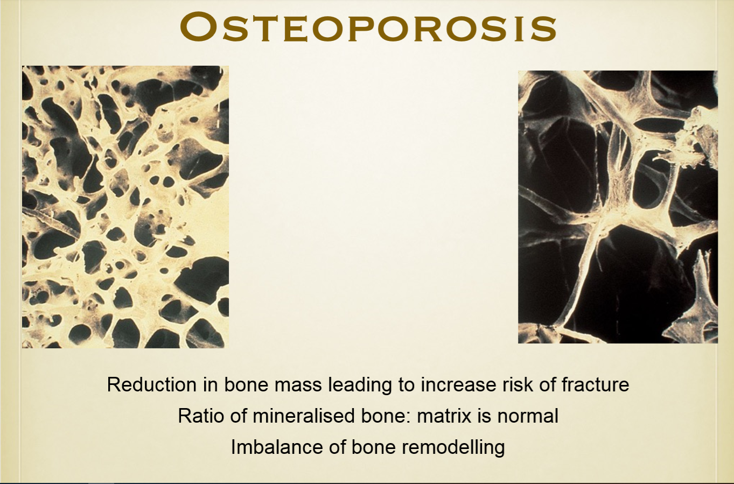

Slide 5
OSTEOPOROSIS
DEFINITION: Systemic skeletal disease characterized by low bone mass and micro architectural deterioration of bone tissue , with a consequent increase in bone fragility and susceptibility to bone fracture

Slide 6
OSTEOPOROSIS CAN ALSO BE CLASSIFIED
1. Primary osteoporosis
• Involutional (most common) - osteoporosis in which no underlying cause can be identified.
Type I (postmenopausal)
Type II (aging related)
• Idiopathic
Juvenile
Adult
2. Secondary osteoporosis - osteoporosis in which there is an underlying cause.

Slide 7
PRIMARY OSTEOPOROSIS
• Postmenopausal osteoporosis occurs in women within 15-20 years after menopause.
• Age-related, or senile, osteoporosis describes the disease in the elderly.
• Juvenile osteoporosis affects prepubescent boys and girls.
• Idiopathic osteoporosis describes the condition in young adults when the cause is not related to another disease

Slide 8
INVOLUTIONAL OSTEOPOROSIS
Postmenopausal (Type I)
Senile (Type 2) Osteoporosis:
• Most common cause of generalized osteoporosis.
• Peak bone mass occurs in the second decade of life.
• Then gradual loss of skeletal mass occurs, beginning in the
➢ fifth or sixth decade of life in men
➢ fourth decade in women

Slide 9
Patients may be
• entirely asymptomatic,
• significant loss of bone mass accompanied by various clinical signs
– Bone pain, particularly in the back,
– Loss of height owing to vertebral compression.
– Increase thoracic kyphosis is apparent (dowagers hump).
– Neurologic complications are unusual.
– Fractures
• Laboratory analysis : elevated urinary hydroxyproline levels.

Slide 10
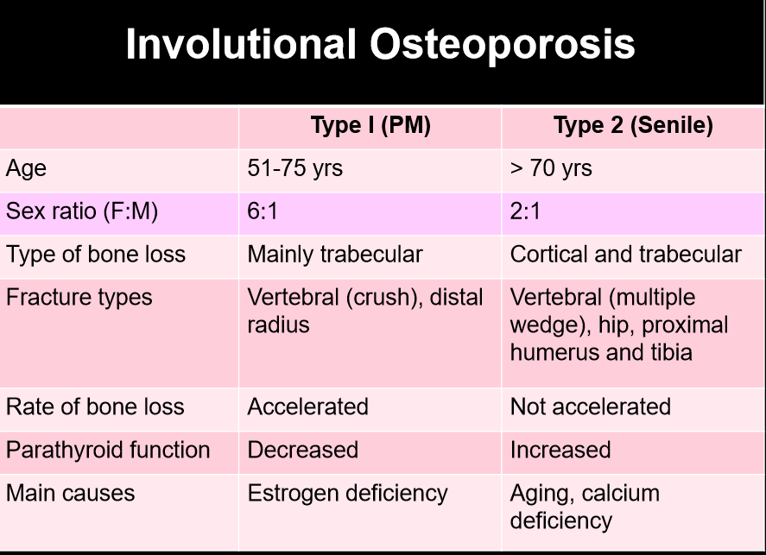

Slide 11
Osteoporosis is one of the most devastating disorders associated with aging.
• Osteoporosis-related fractures result in significant morbidity and mortality.
• Characterized by qualitatively normal but quantitatively deficient bone.
• Generalized decrease in bone mass is seen.
• Bone is normal structurally as determined by histological and chemical analysis
• Radiographs in patients with osteoporosis reveal increased radiolucency of bone (Osteopenia)
• Osteopenia occurs when bone resorption exceeds bone formation.

Slide 12
Major risk factors
-Age > 65 years
-Systemic glucocorticoid therapy of >3 months duration
-Mal-absorption syndrome
-Primary hyper parathyroidism
-Propensity to fall
-Osteopenia apparent on X-ray film
-Hypo-gonadism
-Early menopause (before age 45)
-Family history of osteoporotic fracture (especially maternal hip fracture)

Slide 13
Minor risk factors
Rheumatoid arthritis
- Past history of clinical hyperthyroidism
- Chronic anticonvulsant therapy
- Low dietary calcium intake
- Smoker
- Excessive alcohol intake
- Excessive caffeine intake
- Weight <57 kg
- Weight loss >10% of weight at age 25
- Chronic heparin therapy

Slide 15
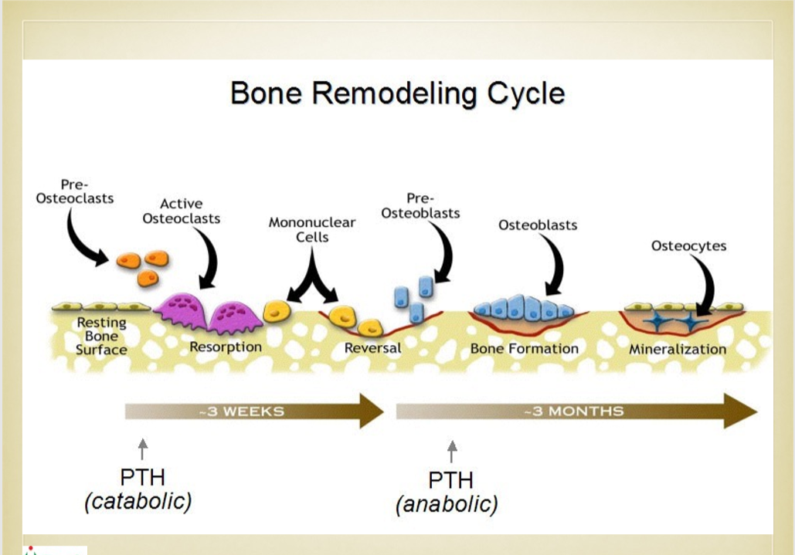

Slide 16
We use dexa for the measurement of bone qualıty

Slide 19
Radiographic Features:
• Generalized osteoporosis is most prominent in the axial skeleton, particularly the
• vertebral column,
• pelvis,
• ribs,
• sternum.
less extensive changes may become evident in the tubular bones.

Slide 20
General radiological features of osteoporosis:
• Increased radiolucency
• Cortical thinning
• Altered trabecular patterns
• Fracture deformity

Slide 21
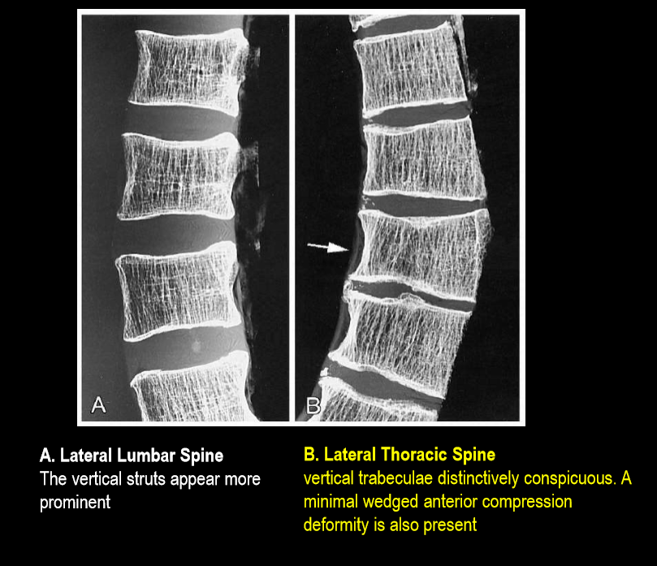

Slide 22
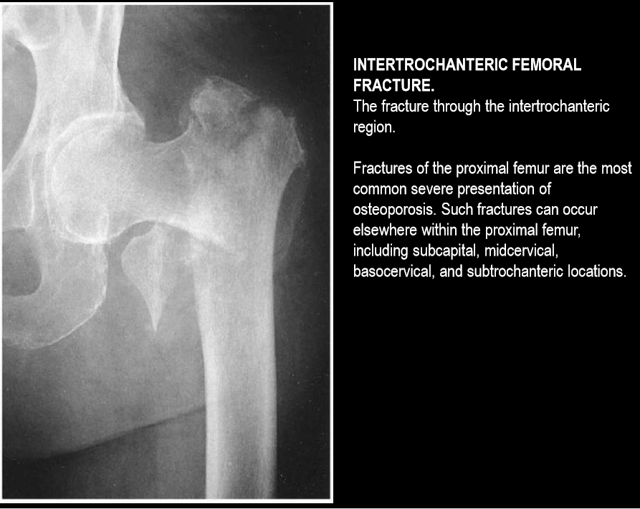

Slide 23
Osteoporosis - Treatment
Lifestyle factors: Falls prevention
• Ca and Vit D
• Bisphosphonates
• Salmon Calcitonin - SC/Nasal
• Teriparatide- PTH
• SERMs
• Monoclonal antibodies (MAbs) (Denosumab)
• Strontium

Slide 24
steroid induced osteoporosis

Slide 25
Osteomalacia
Deﬁciency or Resistance to Vit D or Phosphate handling problem
• Defective Mineralization of bone
• Proximal Myopathy, Bony pain, Malaise
• SAP raised, Ca and Vit D low or normal
• PO4 low or normal

Slide 26
Diseases of Mineralization: Osteomalacia and Rickets
■ Osteomalacia is a term that is used to encompass a group of diseases in adults, the essential feature of which is a delay in mineralization as osteoid is laid down. mineralization as osteoid is laid down.
■ Rickets is the equivalent term used in children where the disease manifests particularly at the growth areas of bone.

Slide 27
Osteomalacia and Rickets
Disease is diagnosed by histology and in sever cases by radiology
Etiology is diagnosed by biochemistry, history and examination
■ Vitamin D  Phosphate  Calcium  Acid  Alkaline Phosphate  Drugs and Toxins

Slide 28
Vitamin D Deficiency
Environmental
housebound; frail elderly; immigrant from low to high latitude; gastrectomy; malabsorption to high latitude; gastrectomy; malabsorption
. Genetic dark skin pigmentation
■ Biochemistry D low; 25D low; 1,25D low to normal ; Ca low; PTH high; Alk Ph high; P low

Slide 29
Impaired 1,25 D production
Environmental chronic renal failure
■ Genetic mutations in 25D 1 alpha hydroxylase (D dependent rickets type 1)
■ Biochemistry D normal; 25D normal; 1,25D low; Ca low; PTH high; Alk Ph high; P high in CRF and low in D dependent ricket

Slide 30
Phosphate
Environmental
dietary phosphate depletion;
prematurity in neonates;
mesenchymal tumors;
renal tubule tumors;
Genetic
mutations in PHEX;
mutations in FGF

Slide 31
Calcium
Environmental
insufficiency of dietary calcium during rapid growth
■ Biochemistry
Ca low ; PTH high; Alk ph high; P low; D normal; 25D normal; 1,25 D high

Slide 32
Acid
Environmental acquired renal tubular acidosis from renal damage
■ Genetic renal tubular acidosis
■ Biochemistry HCO3 low; D normal; 25D normal; 1,25 D low to normal; Ca low; PTH high; Alk ph high; P low

Slide 33
Alkaline Phosphatase
■ Genetic Hypophosphatasia
■ Biochemistry Alk ph low; D normal; 25D normal; 1,25 D normal; Ca normal; PTH normal; P normal

Slide 34
Drugs and Toxins
Environmental
Etidronate; Fluoride; Aluminum
Biochemistry
Alk ph normal ; D normal; 25D normal; 1,25 D normal; Ca normal; PTH normal; P normal

Slide 35
osteomalacia - Causes
• Reduced availability of Vitamin D
• Diet: Oily ﬁsh, Eggs, Breakfast cereals
• Minimal sun exposure
• Dark skin, skin covering when outside
• Kidney failure
• Malabsorption
• Epilepsy: Phenytoin, Phenobarbitones
• Genetic disease

Slide 38
Treatment
• Diet rich in Sea foods/ Fortiﬁed Milk
• Exposure to Sunlight
• Vitamin D Supplements- IM/Oral
• Calcium supplements

Slide 39
THİS İS A BAD SUBJECT FOR THE ORTHOPEDİSTS

